Slide 1
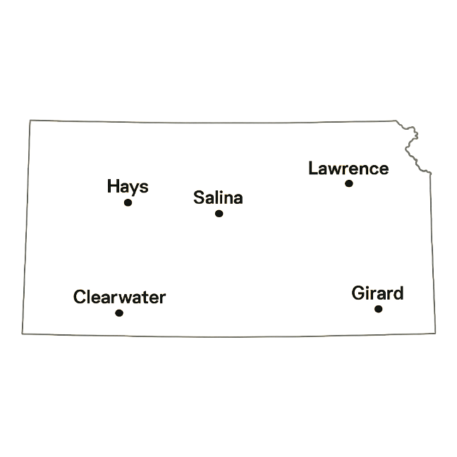
E-Rate 2026 for Kansas Schools
Don Dietrich, Lori Thompson, Valerie Thompson
BTU Consultants, LLC
(Includes content from USAC Training September 2025)

Slide 2
E-Rate 2026 Agenda
8:30am – 10:15am
E-Rate News, Refresh & Updates
Websites and Resources
Your E-Rate History and Open Data
Preparing for E-Rate
Changes for 2026 Application
CIPA, Cat2 Budgets, Categories, Eligible Items & Locations
Applying for E-Rate & Competitive Process
Forms 470, 471 – FRN Line-Item Details
BREAK
10:30am – 12:30pm
E-Rate Approval and Acceptance Process
PIA Review, Forms 486 & Form 500
Form 498, BEARs and Discounts
USAC Open Data downloads
Record Keeping and Change Control
Appeals & Audits

Slide 3
What’s New for 2026?
https://www.fundsforlearning.com/news/2025/06/supreme-court-decision-preserves-e-rate-funding-new/

Slide 4
What’s New for 2026?
New Cat2 Budget Multipliers and Funding Floor
The C2 budget multipliers and the funding floor for each five-year funding cycle are set once at the beginning of the cycle and apply to the entire cycle.
In June 2025, the FCC announced C2 budget funding floors and multipliers for the FY2026-2030 funding cycle (see DA 25-471).
The school multiplier is $201.57 per student.
The funding floor is $30,175 (i.e. <150 students)
Applicants will be required to validate their student counts in the first year they apply for category two support during the FY2026-2030 cycle. Their category two budget will be set for the five-year period.

Slide 5
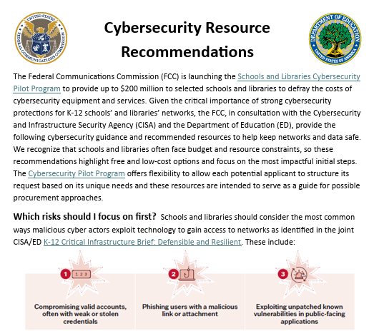
What’s Still Going on in 2026?
Cyber Security Pilot Program
⬅This document contains links to additional resources for cybersecurity

Slide 6
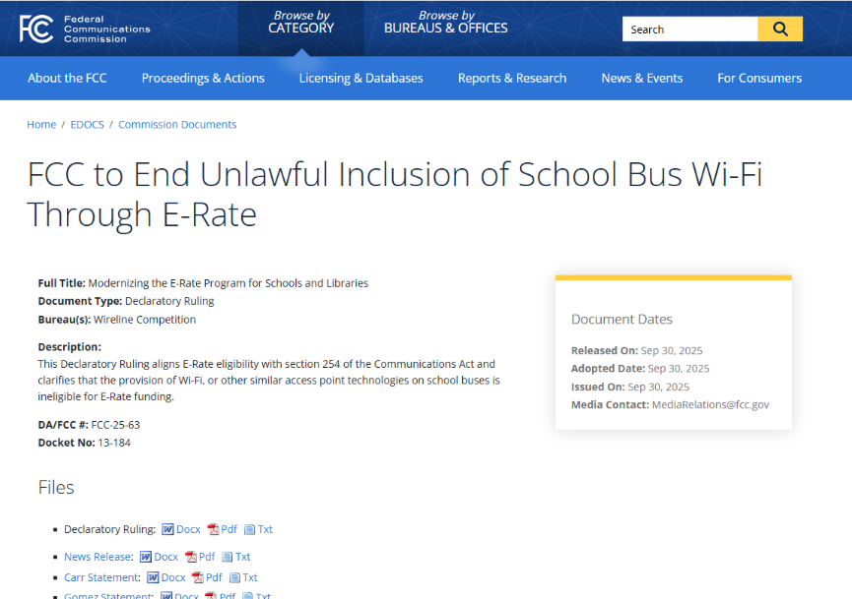
Hotspots & Bus WiFi
Gone for 2025 and forward
FCC Reverses Eligibility of BusWiFi & Hotspots

Slide 7
Handouts for today…available on KSDE Website
Copy of this presentation (.ppt)
E-Rate Binder set of folders (Windows)
E-Rate Project Tracking Template & Example (.xls)
Draft Eligible Services FY2024 (.pdf)
Form 470 Item 13 requirements (.docx)
Form 470 Response Log Template & Example (.xls)
Sample Bid Evaluation (.xls)
Sample RFPs (new) (.docx and .xls)
Asset Inventory USAC Sample (.pdf)
SLD EPC Getting Started Guide (.pdf)
Sample E-Rate Contract 2024 (.docx)
KSDE E-Rate Website

Slide 8
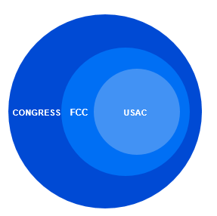
Overview
WHO MAKES THE RULES?
Congress wrote the Telecommunications Act of 1996, which directed the Federal Communications Commission (FCC) to establish the E-rate Program and other programs.
The FCC issues orders that set rules and policies for the program and gives direction to the Universal Service Administrative Company (USAC) through orders.
USAC is responsible for the day-to-day administration of the E-rate Program.
©2019 Universal Service Administrative Co.
SLD – Schools and Libraries Division is one division within USAC

Slide 9
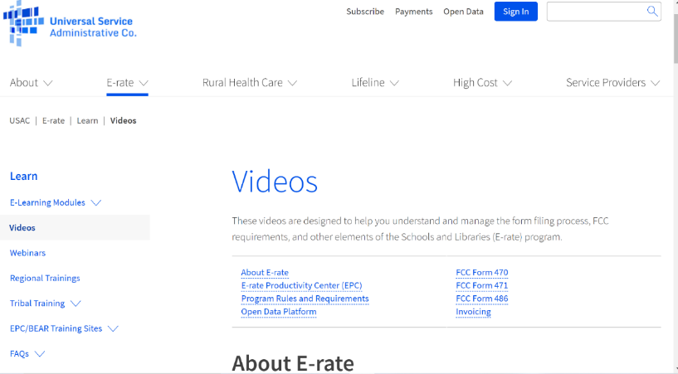
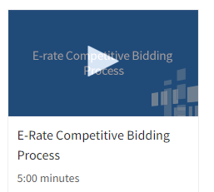
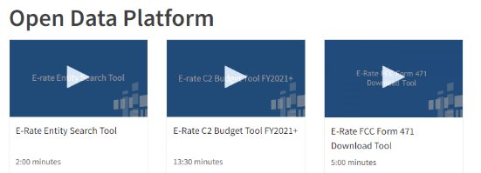
E-Rate 2026 – USAC Online Training Series
Trainings - Universal Service Administrative Company

Slide 10
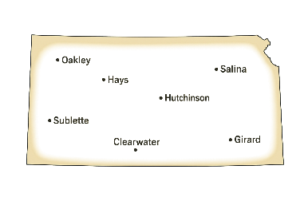
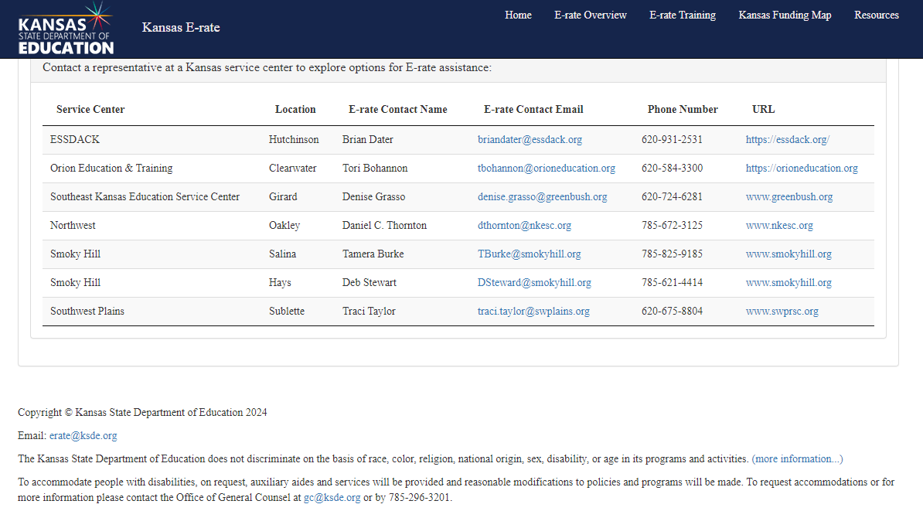
E-Rate 2026 – KS Resources
KS Service Centers

Slide 11

First Some Buzzwords…
BEN – Billed Entity Number - A unique number assigned by USAC to each billed entity (school, library, or consortium) that pays for services.
FRN – Funding Request Number - A unique number that USAC assigns to each funding request in an FCC Form 471.
FY – Funding Year – see next slide
NIF – Non-Instructional Facility - A school building without classrooms or a library building without public areas.
SPIN – Service Provider ID Number - A unique number that USAC assigns to each service provider once that service provider has submitted the FCC Form 498 to USAC.

Slide 13
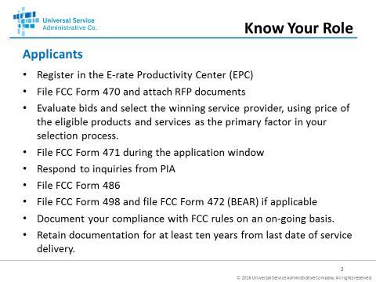
Today
Mar 2026
Oct 2026

Slide 14
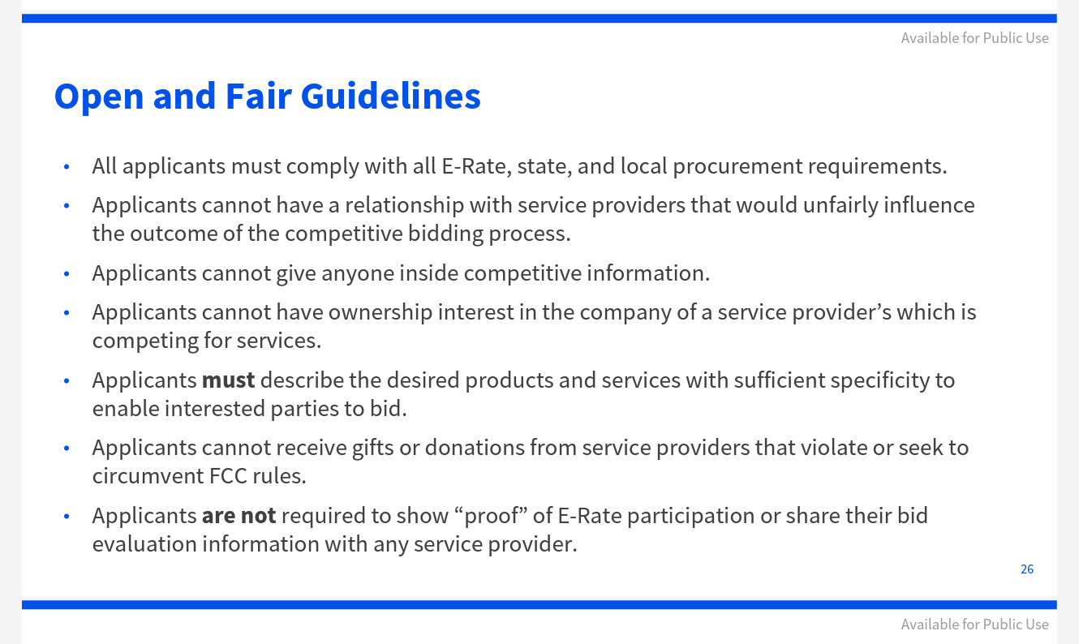
Fair and Open Competition:

Slide 15
E-Rate Process – (E-Rate in 24 30 hours / year)
Begin every new funding year with …
E-Rate 20xx Folder
E-Rate Project Tracking spreadsheet
E-Rate Binder
Document all activity as the funding year unfolds
Draft & revise in Excel – cut & paste into EPC
Schedule tasks vs respond to deadlines
You will be working on 2 or 3 folders (years) at once

Slide 16
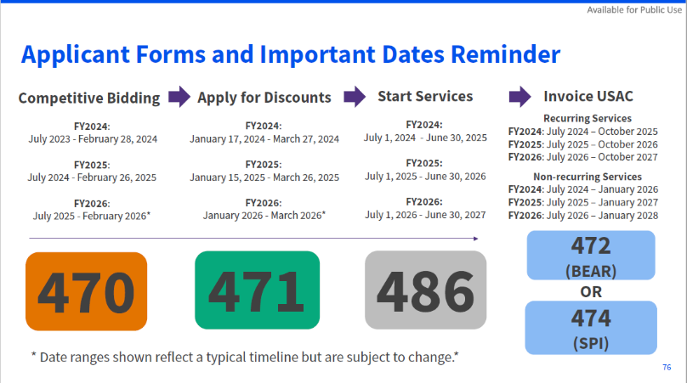

Slide 17
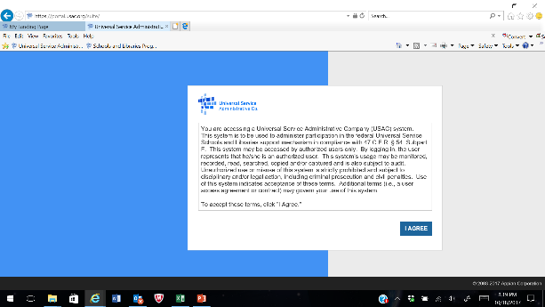
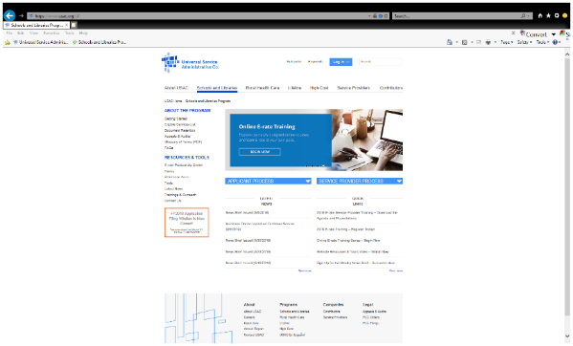
EPC Portal vs SLD (USAC) Website
Login Required
Contains all info for YOUR school or district
All Forms filed here
NO Login Required
Public website
Contains info on E-Rate Program
OPEN Data is here
No Forms filed here

Slide 18
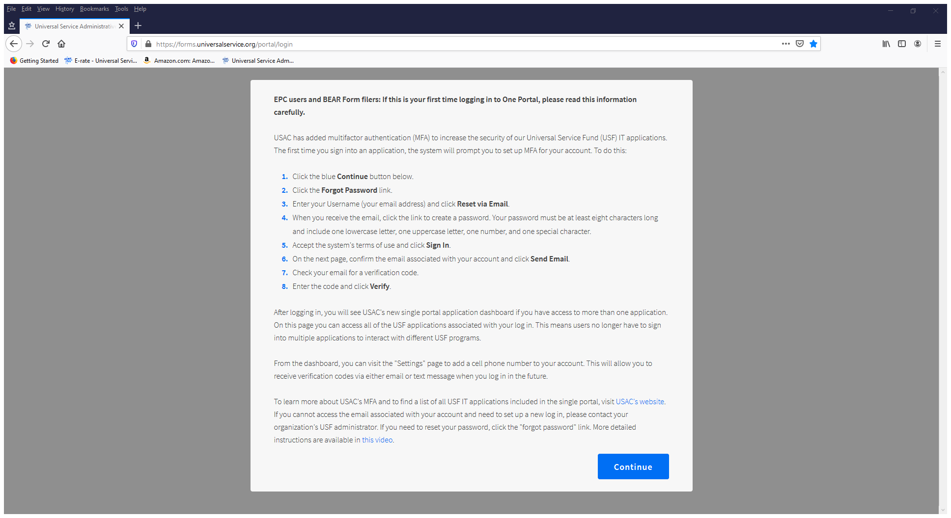
One Portal – first time login
https://forms.universalservice.org/portal/login

Slide 19
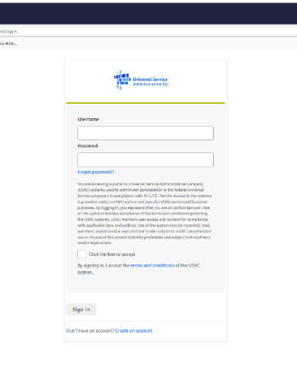
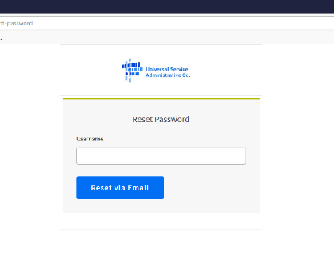
One Portal – first time login
Just click on ‘Forgot password’
Enter EPC Username (email address)
Click on ‘Reset Via Email’
Message will display saying to check your email and follow instructions to get back to login screen

Slide 20
One Portal – first time login
Enter new password and verify
At least 8 characters
Upper and lower case
At least 1 special character
Cannot match any of your recent passwords
Verify your email address and click ‘Send Email’

Slide 21
One Portal – first time login
Check your email for 6 digit passcode
Enter passcode and click Verify
Continue to EPC or
You can setup phone as alternate device

Slide 22
E-Rate Productivity Center – Next Steps
Logon to confirm your identity as Administrator
Add users and/or consultants
Grant rights
Full or Partial for Forms 470, 471, 486 etc.
School Official or General Financial Contact for 498
Check all existing entities for correctness (don’t forget NIFs)
Update your Enrollment / NSLP data – your Cat2 budget depends only on your enrollment. Your total budget for the next 5 years will be set when you submit your first Form 471 for Category 2 items.

Slide 23
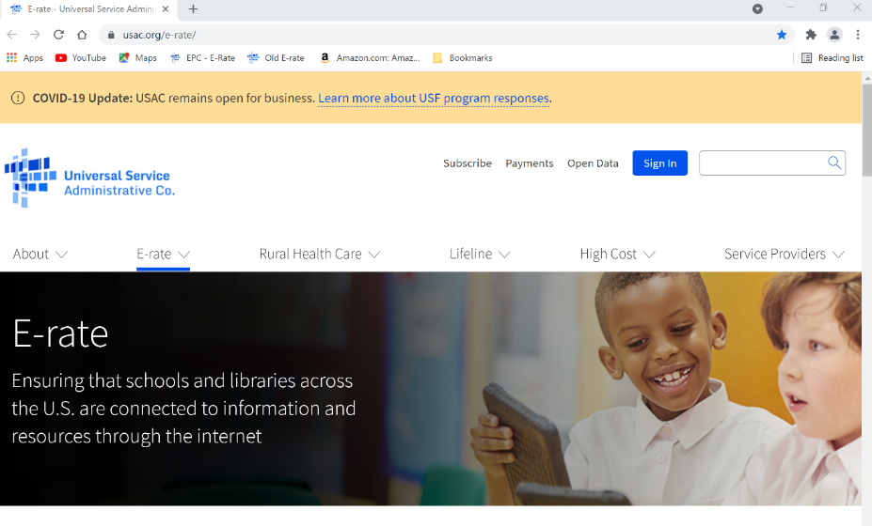
SLD Website
http://www.usac.org/sl/

Slide 24
SLD website – your school’s E-Rate History
Form 471 Funding Tools and Open Data
Form 471 Summary Report – “Funding Tools - FRN Status Tool” – shows high level details on each FRN by Funding Year by BEN
Open Datasets – contain information on all details of Forms 470, 471 and 472 and 474 (BEARs and SPIs). “USAC Open Datasets”
Open Datasets have both Original and Current data for each FRN. Current is actual, approved data (after PIA).

Slide 25
Form 471 Summary Report - by BEN by Year
SLD Funding History MS 07-17-25

Slide 26
Form 471 Line-Item Report
Mahomet Line-Item Report 2023.xlsx
E-Rate Request for Discount on Services: FRN Line Items (FCC Form 471 and Related Information)

Slide 27

GETTING READY
TO
APPLY

Slide 28

E-Rate Annual Cycle - 7/1/xx through 6/30/xx
Verify Portal Information NOW
Plan & File Form 470 Oct - Nov
Assess Technology Needs / Budgets
Gather Discount Information
Develop Competitive RFPs (if required) Nov - Dec
Advertise
Vendor Conference(s)
Vendor Responses Received
System / Vendor Selection Dec - Jan
Board Approvals
Contract Negotiation
Final Contracts Signed Jan
Forms Submission to SLD (Form 471) Feb/Mar 2026
Implementation (Form 486 / 500 / 472) July – June

Slide 29
E-Rate Process – Case Study
“Interview yourself” to fill in the blanks in Project Tracking Spreadsheet
What fields need to be changed and what fields stay the same from last year to this?
What services are under multi-year contract and do not need a Form 470?
What new services are needed and what existing services can go away?
Build your annual calendar from today through 471 filing

Slide 30
E-Rate Program Rules – Basic Requirements
Focus on delivery of Broadband and WiFi
Competitive Process – requests must be posted for 28 calendar (not business) days
All funds must be used for
eligible goods and services
installed at eligible facilities
provided by eligible service providers
All records must be kept for 10 YEARS – from the last activity on the application!!!

Slide 31
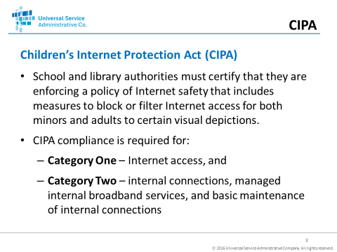
You may need CIPA compliance for E-Rate

Slide 32
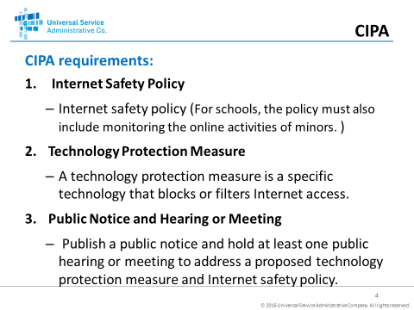
CIPA Requirements

Slide 33
CIPA Requirements

Slide 34
ELIGIBLE GOODS
AND SERVICES

Slide 35
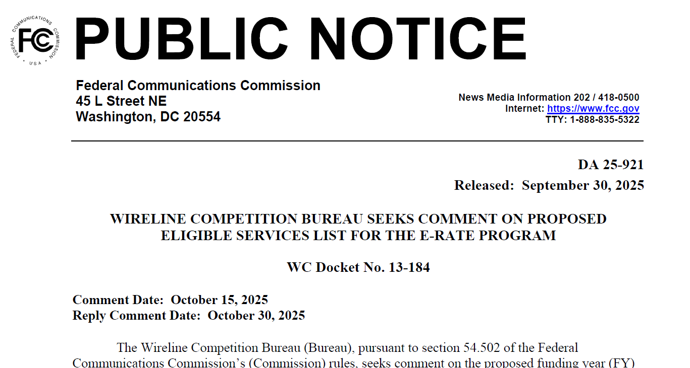
Eligible Services List (ESL) 2026
Draft Eligible Services List 2026

Slide 36
E-Rate Eligibility - What’s Covered
Category 1 – no budget limit – technology neutral
Data Transmission (WAN Services)
Internet Access – no longer includes School Bus WiFi or offsite Hotspots
Category 2 - $201.57/student FY2026-2030
Internal Broadband and WiFi - LAN/WAN wired and wireless components including cabling, switches, routers, racks, UPS. Includes installation and maintenance on all eligible items (no servers). Includes licenses and operating system software.
Basic Maintenance – only for work actually performed
MIBS - Managed LAN and Wi-Fi (can include both equipment and ‘management’ - does not have to come from same supplier)

Slide 37
E-Rate Eligibility - What’s Covered

Slide 38
What’s Not Covered - same as forever
Servers, Voice and Video equipment
Computers, Telephone instruments, Video Cameras
Power infrastructure
Physical security or construction
Application Software
Internet Content
Consulting Services, Training, Personnel Costs

Slide 39
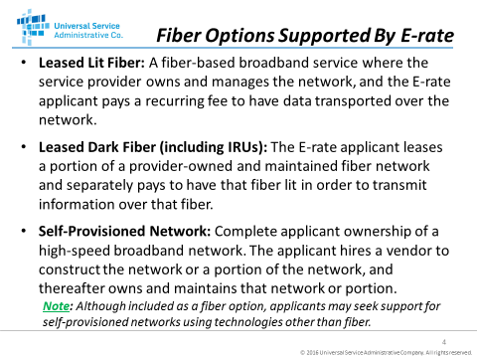
Eligible Fiber Services 2026 – Cat1

Slide 40
Eligible Services 2026 – Cat1
Category 1 – Dark Fiber Clarifications
Modulating electronics and equipment necessary to “light” the dark fiber are now eligible as Category 1 funds
Special construction charges for dark fiber may include the costs of installing fiber from the service provider’s existing network all the way into the applicant’s building
There are many technical requirements for 470/RFP if seeking “self-provisioned fiber”
FORM 470 and RFP CANNOT STATE A PREFERENCE FOR ANY SPECIFIC TECHNOLOGY if asking for dark or self-provisioned

Slide 41
Eligible Services 2026 – Cat2
Category 2 – Internal Connections and Maintenance
Internal Connections
Cabling, switches, access points, UPS’s…can also include installation, initial configuration and operator training
Basic Maintenance of Internal Connections – no changes
Break-fix materials and labor to repair any eligible device – usually filed based on estimates and equipment inventory. Cannot include Network Monitoring
Managed Internal Broadband Services – no changes
Outsourced operations and management of your network. Equipment can be owned by district or vendor. Usually fixed fee – monthly or annual. May include Network Monitoring
Can be in addition to normal BMIC services
Many new vendors are catering to this market (Wyebot, SecureDesigns…)

Slide 42
ELIGIBLE
LOCATIONS

Slide 43
E-Rate Eligible Locations – only four types of entities exist
Parent – usually a district
Child – usually a school (entity sub-types)
Annex – usually part of a school
NIF - Non-Instructional Facility
SCHOOLS:
Administrative buildings
School bus barns and garages
Cafeteria offices
Facilities associated with athletic activities
LIBRARIES:
Administrative buildings
Bookmobile garages
Interlibrary loan facilities
Library technology centers
43

Slide 44
E-Rate Eligible Locations – Category 2
Category 2 services for administrative sites (NIFs) are NOT eligible unless those services are “essential for the effective transport of information to a classroom or library”.

Slide 45
E-Rate Eligible Locations – update your list
What locations (entities) are you responsible for ?
Update all Entity Information in EPC
School Names, addresses…
Enrollment and Free & Reduced
Part time Students are no longer allowed
What is this year’s C2 budget for the district ?
What is this year’s discount rate?
If necessary use ‘One Number’ total for Enrollment (enter at bottom of home page under Cat2 Budget)
Add all information to EPC and Project Spreadsheet

Slide 46
Category Two Budget for 2026
Every Billed Entity will have a Cat2 Budget of $201.57/student for the period from2026-2030
The Funding Floor (per school minimum) is $30,175
C2 budget is determined when the first C2 Form 471 is certified. It will not change for the period.
Total Cat2 Budget will be managed by district not by individual school
Budget is PRE-DISCOUNT. Ex: with 1000 students and a 50% discount your budget is $201,570.00 and the discount you receive is $ 100,785.00.
C2 Budget Order for FY26-FY30

Slide 47
E-Rate Category 2 for 2026
Keep track of Cat2 funds used to know what’s available. You can use a Form 500 to return unused funds for re-use in coming year.
EPC will show your original and current Cat2 Budget
Project Tracking Spreadsheet

Slide 48
DISCOUNTS

Slide 49
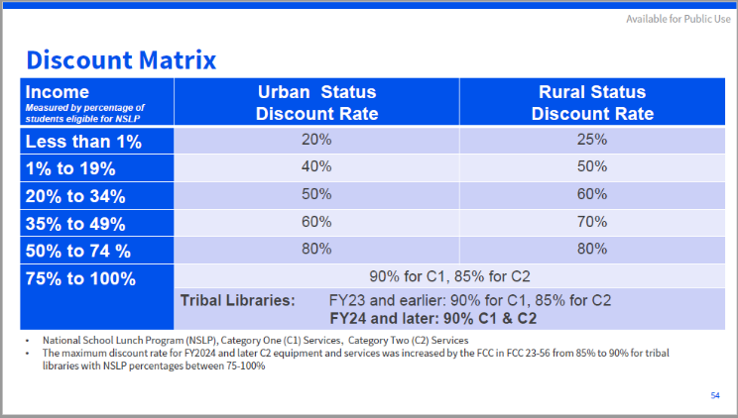
E-Rate Discounts – No changes for schools

Slide 50
Calculating Discounts - two variables
The percentage of students eligible for the National School Lunch Program (NSLP) or an equivalent measure of poverty
The urban or rural status of the county or census tract in which the school or library building is located
Find both at http://e-rateks.ksde.org/resources.aspx

Slide 51
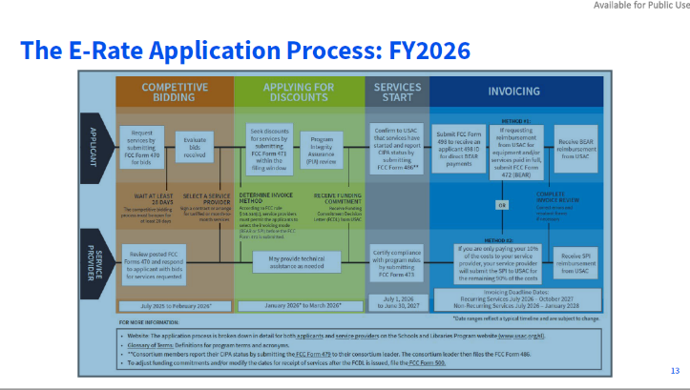
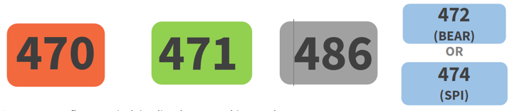
Notes:
This is the functional year – next slide is by Form

Slide 52
Applying for E-Rate
Form 470

Slide 53
E-Rate Form 470 – What’s it for?
Filing Form 470 opens a competitive bidding process
can also issue a Request for Proposals (RFP)
RFP is not required under FCC rules
Form 470 ‘smart’ menus
Your selections determine your next questions
Drop down menus that prevent errors and omissions
You can always backup and start over
Remember the difference between Internet and WAN

Slide 54
E-Rate Form 470 – Gotcha’s
You must wait at least 28 days from the submission date before signing a contract for services – this is the ACD
If you are under a multi-year contract from a previous year, you do not need to file a Form 470 every year
If you are under Month-Month or Tariff rates, you must file a Form 470 every year
Include willingness to accept multi-year contracts and any restrictions on them
Must include any pass/fail requirements!!
If you include Basic Maintenance on your 470 you must include it on your RFP (RFP and Form 470 specs must match)

Slide 55
E-Rate Form 470 – Gotcha’s

Slide 56
E-Rate Form 470 – 28 Day Rule

Slide 57
E-Rate Form 470 – 28 Day Rule

Slide 58
E-Rate Form 470
Notes:
Recent SLD decisions say that you must clearly specify the deadline date in order to reject proposals rec’d after.

Slide 59
E-Rate Form 470 – specify a cutoff date!
Consider adding “State or Local Procurement Requirements” to protect yourself…
Responses must be received via email only to email@myschool.org.
Responses must include detailed pricing and descriptions.
Responses must be rec’d ON OR BEFORE the Allowable Contract Date.
Vendor must agree to SLD (SPI) invoicing.
Multi-year contracts and voluntary extensions accepted.
Vendor is aware of and agrees to follow SLD guidelines on Lowest Comparable Price.
SPAM and/or robotic responses will not be considered valid bid responses and will be disqualified from consideration.
Failure to comply with any of the items above may be grounds for disqualification.
Form 470 Item 13 Requirements
Notes:
Recent SLD decisions say that you must clearly specify the deadline date in order to reject proposals rec’d after.

Slide 60
E-Rate Process
Draft 470 descriptions into Project Tracking Spreadsheet
Put in enough detail to allow a fair bid based on 470 specifications alone or…
Put in a reference to an RFP
Can be a one-page description
Can be a formal RFP document
You must upload a copy
Sample RFP#1
Sample RFP#2
Sample RFP#3
Sample RFP#4

Slide 61
E-Rate Form 470 - Reminder
Reminder - Changes to Form 470 for 2025/2026
Ability to upload RFP documents after certification
Will ask you if this is a “Substantial Change” and automatically reset the Allowable Contract Date
Could be easier to just cancel and re-issue a new Form 470
Ability to cancel Form 470 and view canceled forms
Notes:
Now go and do a Form 470…

Slide 62
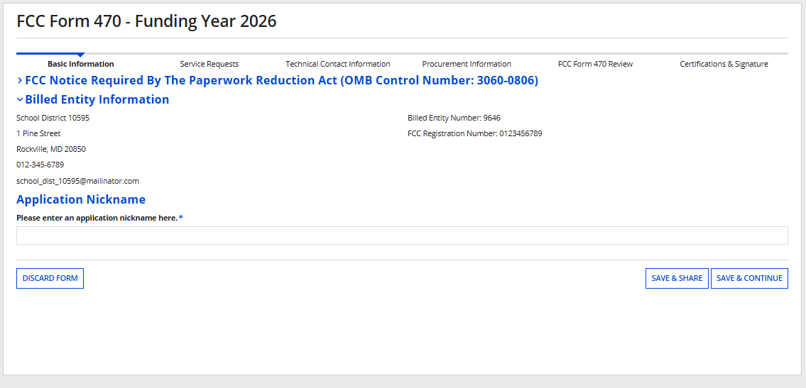
E-Rate Form 470
Form 470
Notes:
Now go and do a Form 470…

Slide 63
E-Rate Project Tracking Spreadsheet
Project Tracking Example 2026
Notes:
Morning Break at 10:15
Restrooms / Vending
Done by 12:30

Slide 64
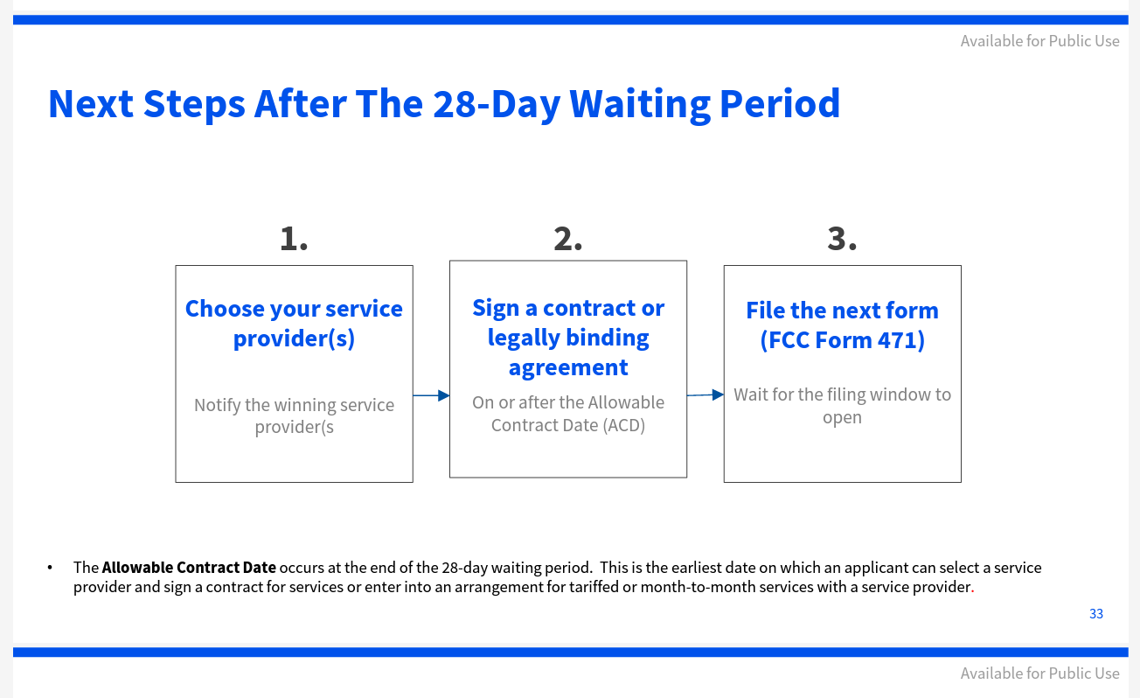
What’s Next…

Slide 65
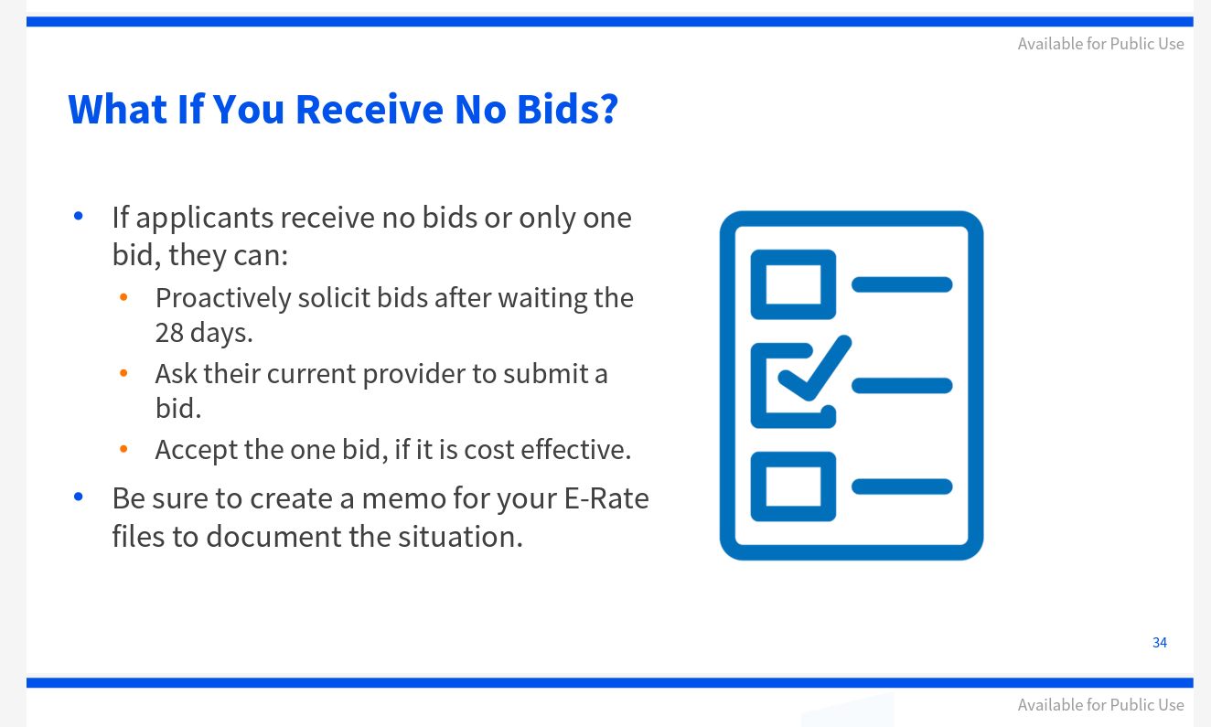
Issues in Competitive Bidding

Slide 66
Vendor Selection – if there’s not a formal RFP
You must document and retain your vendor selection process
Use this template or one of your own to record Form 470 responses from vendors
Keep logs of all vendor emails
Can also use for bid evaluations
Form 470 Response Log Spreadsheet

Slide 67
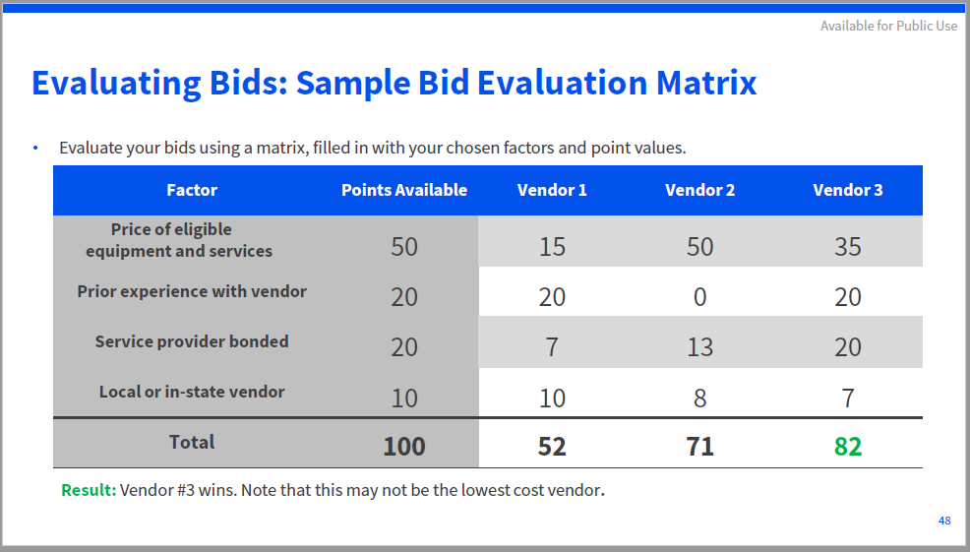
Vendor Selection – if there is a formal RFP
How to Construct a Bid Evaluation (EPC Website)
Sample Bid Eval

Slide 68
Vendor Selection – Do You Need a Contract?
YES – for Category 1 FRNs that are not Tariff or MTM
YES – for all Category 2 FRNs
Applicants must have a signed contract or other legally binding agreement in place prior to submitting their FCC Forms 471 to USAC.
Contracts can cover more than one year or contain extensions, but applicant must have indicated these options in the Form 470

Slide 69
Contracts must be entered into EPC prior to 471
Gather all information on your contract or have a soft copy on file
Enter via Portal
Contracts can be corrected only up to the point of submission – no changes after that
Signed Contract Kajeet - MS 2024
Sample E-Rate Contract 2026
Notes:
Go Online and enter Contract for Cat2

Slide 70
E-Rate Process – Case Study
Draft bid results into Project Tracking Spreadsheet
You will need this information for the Form 471
For each FRN you should have…
Service Provider and SPIN
Description, Quantity and Unit Cost (Cat1 and Cat2)
Total Monthly and/or Total One-Time Costs
Form 470 Reference if needed (470’s are pre-loaded)
Contract Reference if needed (Contracts are pre-loaded)
Recipients of Service and Cost Allocation if needed

Slide 71

Applying for E-Rate
Form 471

Slide 72
Requesting Funding
FCC Form 471
Funding Request
FRN Line Item
File one per category of service
Add one per service type, service provider, FCC Form 470, contract/service agreement
Provides summary information
Each request is identified by an ID number called a Funding Request Number (FRN)
Add one or more per FRN
Provides details about the individual services or products listed on the funding request
Internet Access
Line Item 1
Category 1
Line Item 2
Digital Transmission Service
Line Item 1
Category 2
Internal Connections: Contract
Line Item 1
Internal Connections: Contract
Line Item 1
Line Item 2
©2019 Universal Service Administrative Co.

Slide 73
E-Rate Form 471 – What will you need
EPC access
Entity and Discount data (already entered)
Contract information (already entered)
Funding Request data (from Project Tracking Spreadsheet)
Manuf / Make / Model
Unit Cost / Quantity and Cost Allocation (if required)
Recipients of Services – only if needed internally
Certification authority

Slide 74
E-Rate Form 471

Slide 75
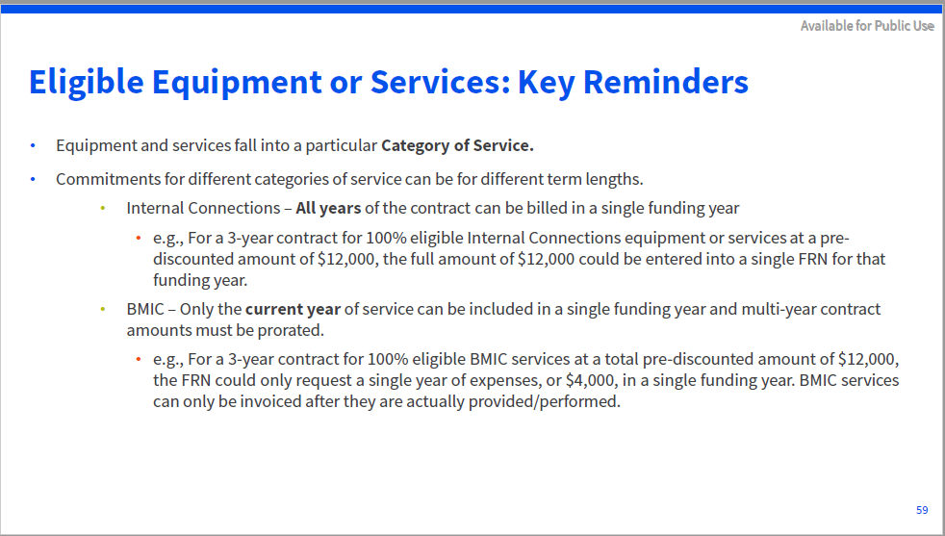
E-Rate Form 471

Slide 76
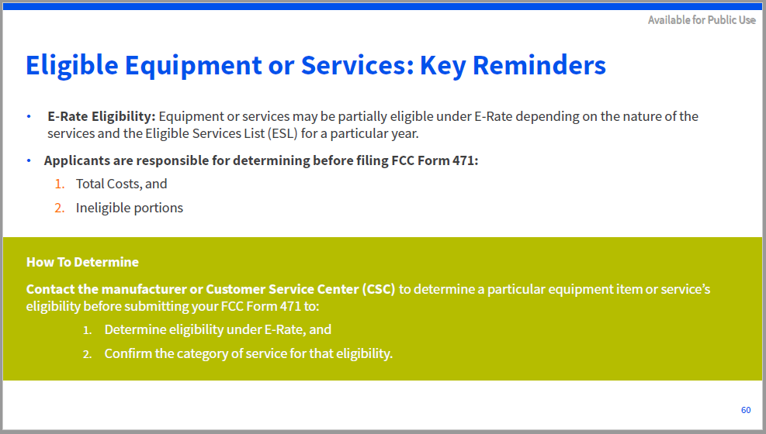
E-Rate Form 471

Slide 77
E-Rate – Remove Ineligible Costs
Vendor Cost Allocation Links: Some manufacturers have websites to help applicants determine if the products they’re listed on their Form 471s are E-rate eligible, partially eligible, or 0% eligible.
* Cisco/Meraki - https://www.ciscoerate.com/ProductEligibility/
* Fortinet - http://erateproviderservices.com/fortinet-home/product-eligibility/
* HP Aruba - https://www.arubanetworks.com/eratetool/
* Juniper - https://www.juniper.net/assets/us/en/local/pdf/faqs/9030313-en.pdf
* Palo Alto - https://www.paloaltonetworks.com/content/dam/pan/en_US/assets/pdf/technology-solutions-briefs/panw-e-rate-eligibility.pdf
* Sophos - http://erateproviderservices.com/sophos-home/product-eligibility/
See link in your handouts: Manufacturers’ Eligibility Percentages

Slide 78
E-Rate Form 471 – Online
Example Form 471
Form 471 Online
Notes:
Go Online and enter Tuscola 471

Slide 79
E-Rate Form 471 – after you certify
Update Project Tracking Spreadsheet with FRN info
Review all documentation in E-Rate Binder
Check all quantities and dollar amounts
If you made a mistake, you should file a RAL Modification request in EPC as soon as possible (under Form 471/Related Actions/RAL Modification)
Prepare for PIA review

Slide 80
PIA Review – What is it ?
Forms 471 are reviewed by Program Integrity Assurance (PIA) for compliance with program rules concerning areas such as:
Competitive bidding process
Contracts
Discount Calculation
Sufficient Budget
Establishing Form 470
Cost Effectiveness
Duplicative Services (Two Internet Lines)

Slide 81
PIA Review ➔ Review Inquiries
Outreach – Initial Review - Commitment
Initial Reviewer should send you an email pointing you to your EPC portal for responses
Some Form 471 applications see Selective Review (SRIR)
Some Form 471s see Special Compliance Review (SCRIR)
All review documents between applicant and SLD are thru EPC portal – but you can email or call the reviewer
Log all activity to Project Tracking Spreadsheet
Hint – use the SLD Call Log tab…60 day rule
SLD may change reviewers on you!!

Slide 82
PIA Review – Corrections Allowed
Clerical Corrections
Examples:
Entered the incorrect amount (i.e., data entered $100 instead of $1,000)
Omitted an entity from the Block 4
Provided the incorrect Form 470 number on the Form 471
Selected the wrong category of service
Submitted an unsigned contract to PIA
Omitted an FRN
YOU ARE ALLOWED TO CORRECT ERRORS – BUT NOT TO CHANGE YOUR MIND

Slide 83
E-Rate Approval & Acceptance!
You will receive an FCDL (Funding Commitment Decision Letter) for each Form 471 that you submit
You will receive email from SLD pointing you to EPC
FCDL is in the NEWS feed of EPC – or search ‘Notifications’ from Landing Page
Shows status of individual funding requests in downloadable .csv file
If this is for Cat2 you should download the Form 471 Detailed Report from OPEN DATA that shows CURRENT details and approved amounts.
Many times the equipment that you are approved for will be different that the equipment that you applied for
Save this as your documentation for equipment inventory.

Slide 84
E-Rate Approval & Acceptance
ALWAYS Appeal a decision you don’t agree with
Call BTU Hotline for assistance
866-372-8302

Slide 85
Accepting E-Rate Funds
Form 486

Slide 86
E-Rate Form 486
Notifies USAC that services have started and invoices can be paid
Verifies / Modifies Service Start Date
Start date cannot be prior to 7/1 of the Funding Year or 486 will go into ‘Review’
Certifies that CIPA is in force (if required) and meets requirements.
Be careful - Service Providers can consider this as “permission to invoice” and USAC will not inform you.

Slide 87
E-Rate Form 486 Deadline
Form 486 must be filed no later than
120 days after the Service Start Date or
120 days after the date of the FCDL
whichever is later.
If the Form 486 is late, the date 120 days before the Form 486 online filing or postmark date will become the start date for discounted services and funding may be reduced. (i.e. they take back the money one month at a time for each month you are late).

Slide 88
E-Rate Implementation Deadlines
Service delivery deadlines
Recurring Services (June 30)
Non-recurring Services (September 30)
For Category 2 - you can request extensions (Form 500) but your request must be filed before current deadline.

Slide 89
E-Rate Form 486 – this is the easy part
EPC Portal – 486

Slide 90
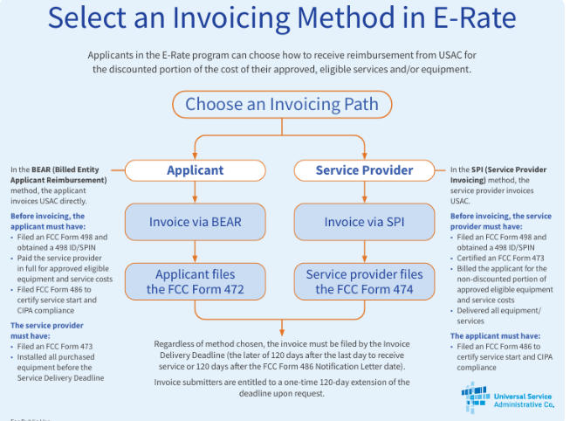

Slide 91
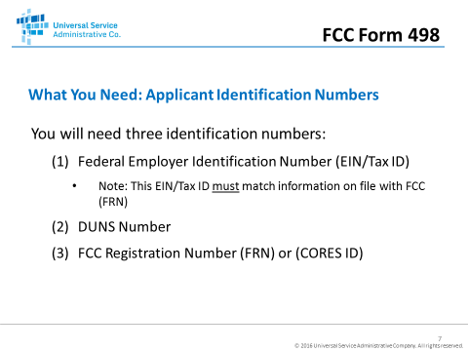
BEAR Process
DUNS Lookup Tool…

Slide 92
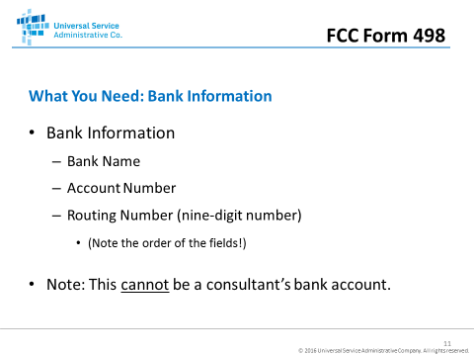
BEAR Process

Slide 93
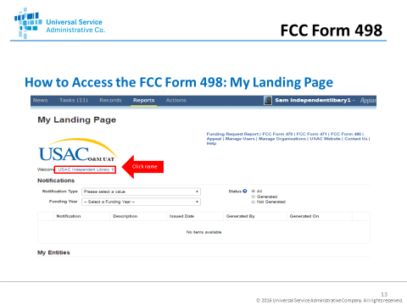
BEAR Process
Click on Organization Name
Click on Related Actions

Slide 94
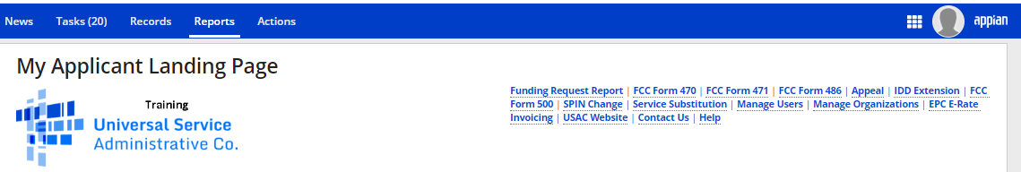
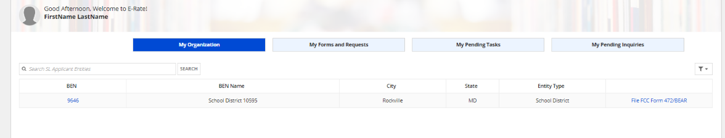
BEAR Process
Click on the checkerboard
Then click on “EPC Invoice”
Click on “File FCC Form 472
BEAR in EPC
BEAR Training Videos

Slide 95
E-Rate Form 500 – it’s only six questions
Change FRN Start Date
Contract Extensions
FRN Extensions – Cat2 time to complete work
FRN Reductions/Cancellations
Cat1 – returns funds to overall SLD Budget
Cat2 – returns funds to your Cat2 Budget
Form is online in EPC – takes less than 5 mins
Notes:
If giving money back - you must keep your own records
Go thru example from SLPS- if you don’t give it back you can’t use it.

Slide 96
Category 2 Record Keeping
You must retain records of all equipment and services including the location, serial number, date etc.
Make up your own tool or use SLD example:
Asset Inventory samples-checklist-inventory-list from USAC

Slide 97
Service Substitutions
Use if you change (buy) anything that varies from what you described on your 471 & Item 21
No FORM, just follow instructions in EPC
Check your Category 2 projects for changes
Vendors may not be paid for equipment or services that do not match your Form 471 detail
The downloaded Form 471 Detailed Report shows the specific equipment that USAC has approved.

Slide 98
SPIN (Service Provider ID Number) Changes
CORRECTIVE changes will be approved (correct errors, mergers, acquisitions etc.)
OPERATIONAL changes are usually not approved unless the original provider goes out of business
Usually approved (or denied) in a few weeks
Vendors will be notified
File Online in EPC

Slide 99
Split FRN – if cutover of Cat1 is delayed…
SLD will not pay for duplicative services
If your new Internet provider was supposed to start on July 1 but didn’t cutover until Aug 1…
Then instead of 12 mos of new provider funding
You need 11 mos of new provider funding
You need 1 month of old provider funding
Open a customer service case to request a SPLIT FRN to re-allocate funds – call BTU for assistance

Slide 100
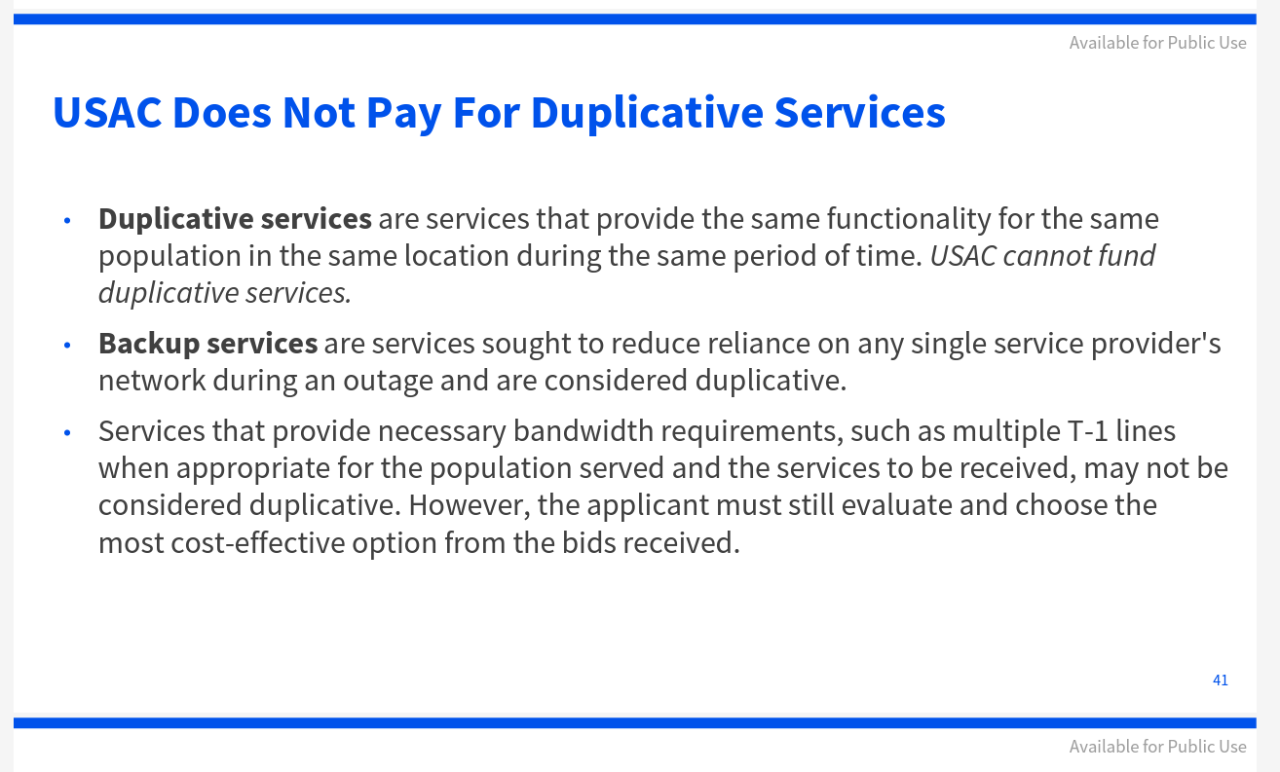
Dual Internet Lines…

Slide 101
Record Retention – “if it isn’t written down it didn’t happen”
Setup an electronic and paper file for each funding year
Email yourself and retain all emails
Make a spreadsheet across years
Monitor at least monthly
Build an E-Rate Binder
Must Retain for 10 YEARS after end of svcs

Slide 102
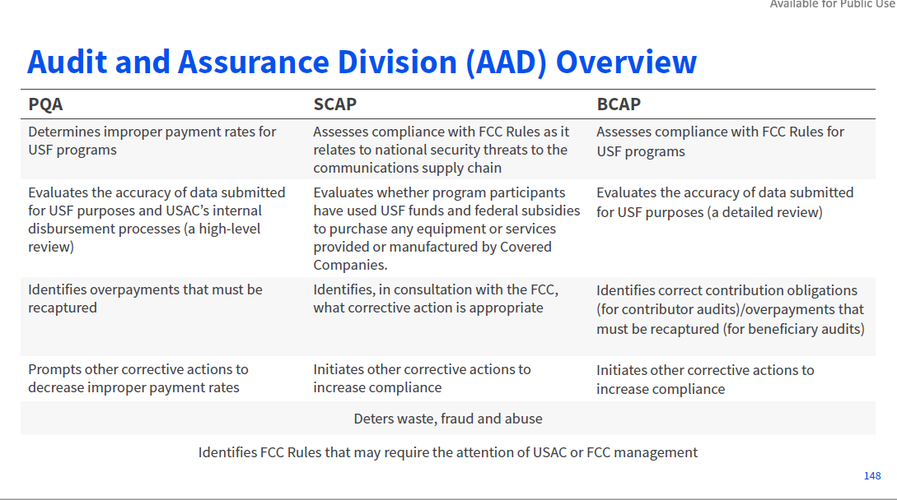

Slide 103
Audit/Assessment Process
Initial Document Requests
• PQA -https://www.usac.org/wp-content/uploads/e-rate/documents/SL-Documents.pdf
• SCAP -https://www.usac.org/wp-content/uploads/about/documents/pdf/audit/Supply-Chain-Audit-Checklist.pdf
• BCAP -https://www.usac.org/wp-content/uploads/e-rate/documents/resources/e-rate-program-list-of-documents-to-retain.pdf

Slide 104
Final Tips
Start early
Set up / update your EPC
Document everything
Email yourself to memorialize
Build and retain an “E-Rate Binder” (10 years)
Plan for an audit

Slide 105

471 Filing Window
FY 2026
opens at noon (EST) on ????
closes at 11:59pm (EST) on ????
LAST DAY FOR Form 470 is ????

Slide 106
Kansas Resources
Kansas Department of Education
http://e-rateks.ksde.org/
Email to erate@ksde.org
Jenni Marlatt
Public Service Administrator
Kansas K-12 E-Rate Coordinator
Information Technology
(785) 296-7931
jmarlatt@ksde.org
www.ksde.org
Kansas State Department of Education
LANDON STATE OFFICE BUILDING
900 SW JACKSON STREET, SUITE 301
TOPEKA, KS 66612

Slide 107
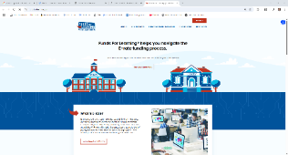
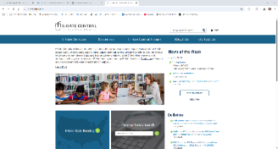
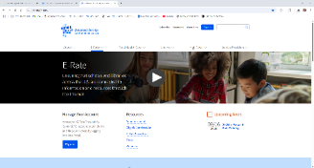
More Resources
Funds for Learning:
http://www.fundsforlearning.com
E-Rate Central:
https://e-ratecentral.com/
SLD Home Page:
https://www.usac.org/e-rate/

Slide 108
Information & Assistance BTU Kansas E-Rate Support Hotline 866-372-8302
Our Goal: Answer all questions – escalate or provide references and contacts as required.
Resources include:
SLD / FCC and affiliated agencies & hotlines
KS Dept of Education
108

Slide 109
Information & Assistance BTU Kansas E-Rate Support Hotline
We Can Provide Advice on:
SLD forms 470, 471, 486, 472, 500
Eligibility of goods, services and locations
Strategy for writing an appeal
SPIN Change, Service Subs, Invoice Extensions
We Cannot:
Prepare, complete or submit FCC forms
Act on behalf of an entity
109

Slide 110
Information & Assistance
BTU Consulting, LLC
Toll Free Support Hotline – 866-372-8302
Email to:
Lori Thompson: lori@btu-consultants.com
Valerie Thompson: valerie@btu-consultants.com
Don Dietrich’s email: ddietrich@e-rateprofessionals.com
Don Dietrich’s Cell Phone: 314-378-1667

Slide 111
Questions ?

